Slide 1
Introduction to Evidence-Based practice
Dr Fathimath Shifaza, PhD, RN, RM

Slide 2
Objectives
To introduce Evidence-based practice
Identify the steps involved in EBP
Evaluate the importance of EBP
Understand the challenges and barriers to the uptake of EBP
Notes:
In this session you will be learning about the key concepts of EBP. When you complete this session you will be able to explain what is EBP and discuss its importance, able to identify the steps involved in EBP, understand the challenges and barriers to the uptake of EBP.

Slide 3
What is EBP?

Slide 4
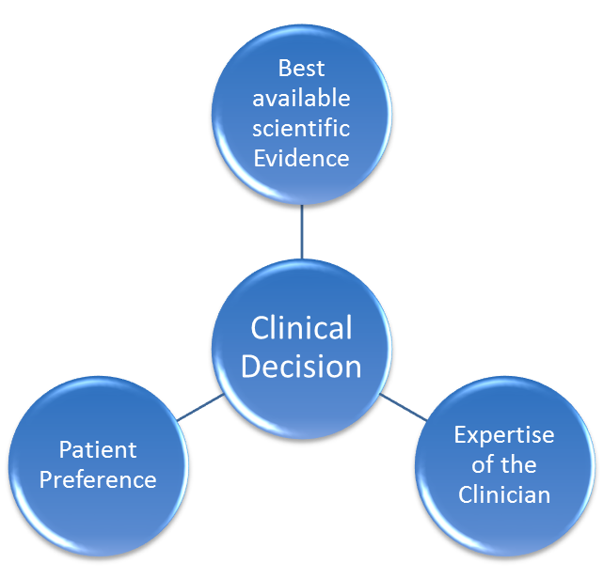
What is Evidence-based practice?
“It is the integration of best research evidence with clinical experience and patient values”
Sackett et al 2000
Notes:
A good definition of EBP is that It is the integration of best research evidence with clinical experience and patient values.
Some people think that EBP means the decisions about health should be based only on evidence from research. that’s a common misunderstanding. Research evidence is only one part of the decision making. What the patient wants and the expertise of the clinician are also important.

Slide 5
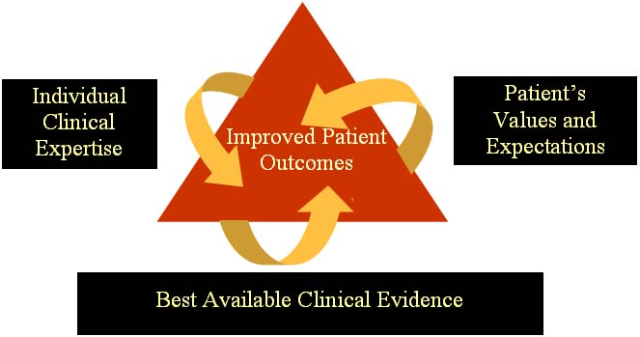
Key Components of EBP
Decisions about care are based on:
A. Research evidence.
B. Clinical expertise, judicious use.
C. Patient values and circumstances.
(Institute of Medicine, 2003)

Slide 6
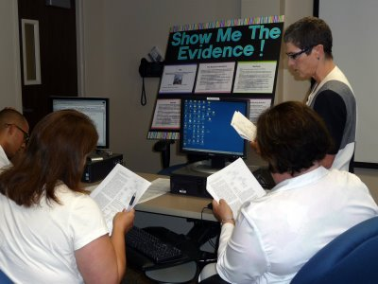
Research Evidence
Randomized controlled trials
Laboratory experiments
Clinical trials
Epidemiological research
Outcomes research
Qualitative research
Expert practice knowledge, inductive reasoning

Slide 7

Clinical Expertise
Knowledge gained from practice over time
Inductive reasoning

Slide 8

Patient Values, Circumstances
Unique preferences
Concerns
Expectations
Financial resources
Social supports

Slide 9
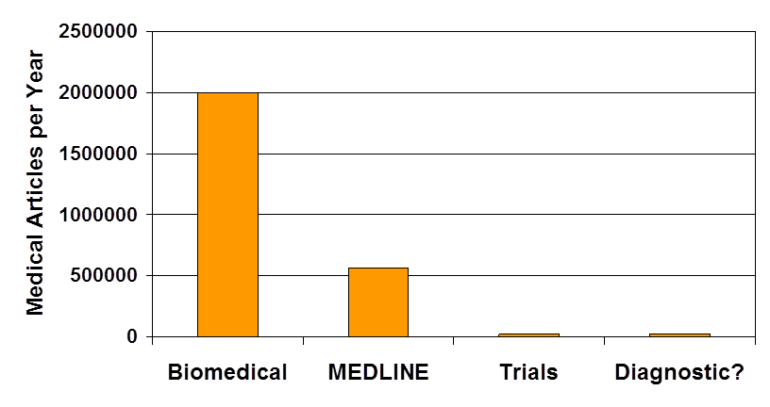



Why we need EBP?
5000/Day
1500/Day
55/Day
Glasziou 2003
Notes:
There are literally millions of published reports, journal articles, correspondence and studies available to clinicians. It is impossible to go through each and every article generated in medical field.

Slide 10
Why Evidence-Based Practice (EBP) ??
Health care delivery is filled with uncertainty and many questions arise in every day practice…
What kind of guidance would be most helpful to my patients?
What clinical assessments and interventions are of the most benefit?

Slide 11
Why is EBP so important?
The underpinnings of EBP is based on
  Safety
  Effectiveness
  Patient Centeredness
  Timelines
  Efficiency
  Equitability
  Justification for health care service delivery
Notes:
So why is EBP so important?
Medicine and nursing are applied science and should be grounded in science. Use of EBP contributes to a safe, effective, patient centred practice.
As healthcare professionals we are obligated to provide the best available care.

Slide 12
Steps of EBP
Developing an EBP question
Find the evidence
Critically appraising the evidence
Applying the findings
Evaluation
Flemming 2008
Notes:
Lets discuss the steps of evidence based practice.
First we identify clinical uncertainty or a situation that could use an improvement and is converted into focused, structured question.
And then we search for the best evidence to answers these clinical questions: in order to do this the focused questions are used as a basis for literature searching to identify relevant external evidence from research
Next we could cretic the evidence we found for validity and applicability, to support answers to clinical questions.
then we implement the best available evidence along side with clinical expertise, the patients perspective, and available resources.
Last of all we evaluate the out comes through a process of self-reflection, audit or peer assessment
The goal is a practice based change resulting from EBP. The idea is continually improve the care we provided as clinicians.

Slide 13
Formulating the Clinical Question
The “PICO” format is used to construct the clinical question specifically
Using PICO format helps you find a needle in a hay stack of research information

Slide 14
P
Patient Population
I
Intervention
C
Comparison (if any)
O
Outcome
Notes:
A good way to start using best available information is using the acronym PICO.
Where P is for patient, population or the problem. Who are the patients, how would you describe them. What is the most important characteristics.
I represents is for intervention, prognostics factor or exposure. Which means what prognostic, diagnostic or preventive interventions are you considering for the patient.
C is for comparison. It the intervention be evaluated against this intervention. What are the main alternative method or diagnosis.
some times there is a placebo,
O is for outcome you would like to accomplish or achieve. What do you hope to accomplish, measure, improve or affect.

Slide 15
Question
Classification/Type
Kind of Study Providing Best Evidence
How can this problem be prevented?
Prevention
Systematic reviews
Randomized controlled trials
Will detecting this problem early, before symptoms, make a difference in my health?
Screening
Randomized controlled trials
What is the number of childbearing women who develop perinatal depression each year as a proposition of the entire female population under 40yrs?
How many childbearing women under 40yrs are living with depression today in the Maldives?
Is audiometry more accurate than whispered voice test for detecting hearing impairment in elderly population?
Does having a stroke increases risk of dementia in elderly people?
Is cervical cancer screening useful for women over 40yrs?
How effective is Foot pumps in preventing DVT?
How good is this test at detecting this problem?
Diagnostic
Randomized controlled trials, Cohort studies
What is the likely outcome of this problem?
Prognosis
Cohort studies
Number of new occurrence of a condition in a population over a given period of time.
Incidence
Cohort studies
What proportion of the population has a particular condition?
Prevalence
Cohort studies
Notes:
So lets start with prevention. You can ask questions about prevention of conditional problem. For eg: How effective is Foot pumps in preventing DVT? For this type of questions RCTs provides the best answer.
Screening means testing for a problem before it causes any symptoms. A screening questions asks is there actually some benefit for people in detecting this problem early? For Eg: Is cervical cancer screening useful for women over 40yrs?
Different kinds of Diagnostic tests can identify conditions with varying degree of accuracy so you can ask questions like is audiometry more accurate than whispered voice test for detecting hearing impairment in elderly population?
In addition to RCTs cohort studies are also used to examine the diagnostic accuracy.
Questions with prognosis involves studying people who have been already diagnosed with a condition for eg: does having a stroke increase risk of dementia in elderly people.
The incidence is number of new occurrence of a condition in a population over a given period of time. An incidence question ask what is the number of childbearing women who develop perinatal depression each year as a proposition of the entire female population under the age of 40?
a prevalence- What proportion of the population is currently living with this problem? Eg: how many childbearing women under 40are living with depression today in Maldives?

Slide 16
Question
Classification/Type
Kind of Study Providing Best Evidence
What should be done to treat this problem?
therapy
Randomized controlled trials
Does combine measles, mumps, rubella childhood immunization lead to an increased risk of autism compared with separate vaccines given at different times?
What environmental exposures apart from smoking increase the risk of lung cancer in male smokers?
How does hysterectomy work compared to a drug to control abnormal endometric bleeding?
What causes this problem?
Etiology
Cohort studies
Will there be any negative effects (of an intervention)?
Harm
Randomized controlled trials, cohort,
case-control studies
Notes:
How well a treatment or other intervention works is a therapy question. This can apply to a drug, surgery , exercise or any other healthcare intervention. Eg: how well hysterectomy work as supposed to using a drug to shut down ovarian function to control abnormal endometric bleeding.
Question of Etiology examines the cause of the problem. An etiology question might be what environmental exposures apart from smoking increase the risk of cancer in Male smokers.
in cohort study the researcher will follow up with or without exposure over time to see if they got disease or not.
and finally Harm : Will there be any negative effects (of an intervention)? Eg: does combine MMR leads to increase risk of autism compared with separate vaccines given at different times?

Slide 17
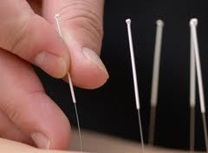


Clinical Query
P
Liam is a 35 yr old smoker who wants to know acupuncture is more effective method of quitting smoking when compared to nicotine replacement therapy.
Liam is a 35 yr old smoker who wants to know acupuncture is more effective method of quitting smoking when compared to nicotine replacement therapy.
smoker
I
O
acupuncture
quitting
C
nicotine
replacement therapy
P | Patient
I | Intervention
C | Comparison (if any)
O | Outcome
Notes:
Now lets look at some examples a d see how the PICO model can help to identify the key components in these clinical questions.

Slide 18

Group work: Identifying areas of practice

Slide 19
Group Work
Identify areas of your practice where there is uncertainty using PICO format. For each question that you focus try to identify what type of question it is. (i.e. intervention, prognosis, therapy etc.)

Slide 20

Group work:
Discussions
Notes:
So lets see what we have got here.

Slide 21
Hierarchy Of Evidence & Different Study Designs
Notes:
Next we will be talking about HIERARCHY OF EVIDENCE & DIFFERENT STUDY DESIGNS

Slide 22

Is all information created equally?
Notes:
First question is is all information treated equally.

Slide 23
Meta analysis
Longitudinal follow-up studies
Cross-sectional studies
Cohort studies
Systematic Reviews
Randomised Controlled trials
Case-controlled studies
Qualitative evidence
Case series and case reports
Notes:
Unfortunately not. In this we can see several studies that are considered as evidence-based. As we move up the pyramid the level of evidence increase and the amount of articles using that time of studies decreases. So there are few meta analysis than qualitative studies.
The pyramid serves as a guideline to the hierarchy of study design. You may not always find the highest level of study to answer your question. In the absence of the best evidence, you then need to consider moving down the pyramid.
So lets go through one by one

Slide 24
Meta analysis: A subclass of systematic reviews. Meta analysis combines and summaries the numerical data in systematic reviews when the results are statistically significant.
Systematic reviews: are articles presenting a synthesis of several articles about a clinical topic.
RCTs: Is a clinical trial which examines the effect of specific outcome measures, where the effect of treatment is examined by comparing the treatment group with at least one control group.
Notes:
A Meta-analysis will thoroughly examine a number of valid studies on a topic and combine the results using accepted statistical methodology to report the results as if it were one large study. The Cochrane Collaboration has done a lot of work in the areas of systematic reviews and meta-analysis.
Systematic Reviews usually focus on a clinical topic and answer a specific question. An extensive literature search is conducted to identify studies with sound methodology. The studies are reviewed, assessed, and the results summarized according to the predetermined criteria of the review question.
RCTs: Is a clinical trial which examines the effect of specific outcome measures, where the effect of treatment is examined by comparing the treatment group with at least one control group. The treatment group may be trailing a drug, device or procedure. Control measures include placebos, active medicine and no treatment. Randomization is done using mathematical techniques such as random number tables.

Slide 25
Cohort studies
Take a large population who are already taking a particular treatment
Or have an exposure, follow them forward over time, and then compare them for outcomes with a similar group that has not been affected by the treatment or exposure being studied.
Cohort studies are observational and not as reliable as randomized controlled studies, since the two groups may differ in ways other than in the variable under study.
A cohort study starts with the exposure and follows patients forward to an outcome
Notes:
Cohort studies take a large population who are already taking a particular treatment or have an exposure, follow them forward over time, and then compare them for outcomes with a similar group that has not been affected by the treatment or exposure being studied. Cohort studies are observational and not as reliable as randomized controlled studies, since the two groups may differ in ways other than in the variable under study. A cohort study starts with the exposure and follows patients forward to an outcome

Slide 26
(NHMRC) levels of evidence
I Evidence obtained from a systematic review of all relevant randomised controlled trials
II Evidence obtained from at least one properly designed randomised controlled trial
III - 1 Evidence obtained from well-designed pseudo randomised controlled trials (alternate allocation or some other method)
III - 2 Evidence obtained from comparative studies (including systematic reviews of such studies) with concurrent controls and allocation not randomised, cohort studies, case-control studies, or interrupted time series with a control group
III - 3 Evidence obtained from comparative studies with historical control, two or more single arm studies, or interrupted time series without a parallel group
IV Evidence obtained from case series, post-test or pre-test/ post-test
NHMRC, (2000),Designation of levels of evidence, A Guide to the Development, Implementation and Evaluation of Clinical Practice Guidelines, Commonwealth of Australia, p 17.

Slide 27
Other ranking schemes include:
  JBI Levels of Evidence Joanna Briggs Institute, Adelaide
  Levels of Evidence and Grades of Recommendation from the Centre for Evidence-based Medicine (CEBM) - EBM Directory

Slide 28
JBI Levels of Evidence
Level I: Evidence obtained from a systematic review of all relevant randomised controlled trials.
Level II: Evidence obtained from at least one properly designed randomised controlled trial.
Level III.1: Evidence obtained from well-designed controlled trials without randomisation.
Level III.2: Evidence obtained from well designed cohort or case control analytic studies preferably from more than one centre or research group.
Level III.3: Evidence obtained from multiple time series with or without the intervention. Dramatic results in uncontrolled experiments.
Level IV: Opinion of respected authorities, based on clinical experience, descriptive studies, or reports of expert committees.

Slide 29

LUNCH
BREAK

Slide 30
Critical Appraisal

Slide 31
Objectives
Discuss elements of critical appraisal
Demonstrate how to read and interpret the elements of a research article
Notes:
So lets begin by explaining the broad elements of critical appraisal and then move on to demonstrate how to read and interpret the elements of research article.

Slide 32
What is Critical Appraisal?
“The process of assessing and interpreting evidence by systematically considering its validity results and relevance.” (Cochrane glossary 2007)
Moving beyond unquestioning acceptance of research findings reported in media.
Adopting a questioning attitude towards research.
Notes:
According to Cochrane glossary critical appraisal is The process of assessing and interpreting evidence by systematically considering its validity results and relevance.”
Critical appraisal require moving beyond unquestioning acceptance of research findings reported in media.
And adopting a questioning attitude towards research.

Slide 33
Why is it important?
Ensures a comprehensive assessment of the whole paper
Allows to identify the strengths and weaknesses of a piece of research
Develops an improved understanding of the research methodology used to conduct the research
Allows to relate the published research to local situation
Enables to identify any bias in the research
Facilitates the implementation of effective interventions in clinical practice
Notes:
Critical appraisal is important because
ensures a comprehensive assessment of the whole paper
allows you to identify the strengths and weaknesses of a piece of research
develops an improved understanding of the research methodology used to conduct the research
allows you to relate the published research to your local situation
enables you to identify any bias in the research
facilitates the implementation of effective interventions in your clinical practice

Slide 34
Elements of a research articles
Abstract
Background
Methods
Results
Discussion
References
Acknowledgement of funding and conflicts of interest
Notes:
So lets look at the elements of a research article. It is useful to know that most of research articles follow the same general format. These are the abstract. The background and rationale for research, research method including the statistical analysis, results of the study, discussion of the study findings, and the references to relate study. At the end or beginning of the article you should always look for the information about how the study was funded and potential conflicts of interests by the authors. We will go through these one by one before we read these papers.

Slide 35
How do you critically appraise an article?
There are three basic questions that need to be answered for every type of study:
Are the results of the study valid?
What are the results?
Will the results help in caring for my patient?
Notes:
The process of critical appraisal can be very time consuming. It requires you to carefully read the whole article, especially the research methodology and statistical analysis - not just the "easy" bits like the introduction, results and conclusion sections!
There are three basic questions that need to be answered for every type of study:
Are the results of the study valid?
What are the results?
Will the results help in caring for my patient?

Slide 36
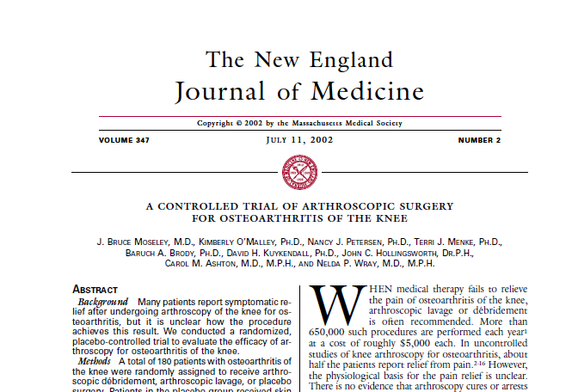
Group Work
Notes:
Here is an article that examine the effectiveness of arthroscopic knee surgery for arthritis.. You will find the article and the critical appraisal tool in your folder. So in groups do the critical appraisal of the article.

Slide 37
Note
Once a critical appraisal has been conducted and it is determined that a practice is backed by rigorous evidence
Notes:
Once a critical appraisal has been conducted and it is determined that a practice is backed
by rigorous evidence, then the practice must be weighed against criteria regarding its theoretical soundness,
clinical support, acceptance within the field, potential for harm, documentation, and empirical support.
However, in the absence of rigorous evidence, practical considerations must be utlized.

Slide 38

Question and Answers

Slide 39
Implementing EBP
      Behaviour change is challenging
      Uptake of evidence is a slow process
      Things does not change overnight
      It takes skills, determination, time, planning and money
Notes:
You should always remember that
Behaviour change is challenging
Uptake of evidence is a slow process
Things does not change overnight
It takes skills, determination, time, planning and money

Slide 40
Challenges and Barriers
Can occur at various levels
  Individual level
  Professional level
  Community level
Its important to recognise and address them prior to implementation
Notes:
Challenges and barriers can occur at various levels
Individual level
Professional level
Community level
Its important to recognise and address them prior to implementation

Slide 41
Group Work
With in the groups, discuss the barriers to uptake of evidence at your work place
Also discuss what strategies you might use to overcome those potential barriers
Notes:
Individual (patients, providers, administrators)

Slide 42
Reference
Bingham, D. (2007). "Every Change Needs a Champion." Journal of Perinatal Education 16(3): 8-10.
Flemming, K. (2008). Asking Answerable Question. Evidence-based nursing : an introduction. N. Cullum. Oxford, UK; Malden, MA, USA, Blackwell Pub.: 18-23.
Fineout-Overholt, E., B. M. Melnyk, et al. (2005). "Transforming Health Care from the Inside Out: Advancing Evidence-Based Practice in the 21st Century." Journal of Professional Nursing 21(6): 335-344.
Rogers EM. Diffusion of innovations. 5. New York: The Free Press; 2003.

Slide 43

Thank you

