Slide 1

WORKSHOP 2
EVIDENCE-BASED PRACTICE CHAMPION PROGRAM
Fathimath Shifaza
MNSc, RN,RM, PhD candidate
University of South Australia
Notes:
Welcome back everyone for the second day of the workshop. Before we begin with today’s session, let us review what we did in the first workshop.

Slide 2
Overview of day 1
How EBP champions can facilitate Evidence-based practice
Identified effective strategies to improve healthcare
Roles of EBP champion
Effective strategies and benefits
History of EBP
The steps of evidence based practice
Formulating and classifying questions
Levels of evidence and different study designs
Critical appraisal of journal article
Notes:
Yesterdays session we covered.

Slide 3
Workshop Agenda – Day 02
TIME | TOPIC
0900-0915 | Opening remarks: over view of the day
0915-1000 | Searching for the best evidence
1000-1015 | Computer lab literature search
1015-1045 | Break
1045-1315 | Computer lab: group work
1315-1415 | Lunch
1415-1500 | Group work continued
1500-1600 | Presentations End of Day 2
Notes:
So lets see what todays sessions are like. Todays sessions are more hand on work. First we will be going through search strategies for different databases.
And then we will practice searching for the questions we formulated yesterday. Lunch is held at Raamba , after that we will continue with the group work and presentations.

Slide 4
Searching for Best Evidence

Slide 5
Objectives
At the end of the session you will be able to:
Identify the types of evidence
Able to identify the different electronic data bases
Search for evidence in primary and secondary data bases

Slide 6
Types of Evidence in Literature
Primary or secondary data
Peer reviewed or not peer reviewed
Scholarly, rate or popular
Notes:
Evidence can be catogorized in Varity of ways

Slide 7
Primary Sources
Includes information from
    journal articles
    books/ book chapters
    dissertations
    conference proceedings
Notes:
Primary resources includes information from journal articles, book chapters, dissertation or conference proceeding s written by the people involved in the original research.
Primary sources always provide full references to others work.

Slide 8
Secondary Sources
Summaries, reviews or interpretations of primary sources
Written after primary sources are presented
Written by those not involved in the original work
Common forms includes: textbooks, systematic reviews, bibliography.
Notes:
Are summaries, reviews or interpretations of primary sources.
Its always written after primary sources are presented and often written by those not involved in the original work.
Common forms includes: textbooks, systematic reviews, bibliography.

Slide 9
Databases
Primary
Secondary
Cochrane library
Jonna Briggs Institute
PEDro
OT seekers
TRIP
CINAHL
MEDLINE
AMED
SPORT Discus
Notes:
Primary
CINAHL
MEDLINE
AMED (allied and complementary medicine).
SPORTDiscus
Secondary
Cochrane library
Jonna Briggs Institute
PEDro
OT seekers
TRIP

Slide 10
Searching Articles
Search Strategy
  Create a search statement (use keywords)
  Use bibliographic databases appropriate to your topic
  Use Boolean Search
  Utilize database features
Notes:
In order to search effectively it is important to become familiar with the database that is being used.
Utilize database features
The searching methods vary from database to database; however most have a basic search function and an advanced search function.

Slide 11
Truncation & Wildcards
search for variant forms of a word as a single search concept, rather than identifying and entering variant words of the keyword as individual concepts.
keyword searches can be searched simply by adding or replacing characters at the ends, beginning, or middle of the word.
Notes:
In many bibliographic databases, online catalogs, and search engines it is possible to refine searches using a technique called ‘truncation.’ Truncation allows you to search for variant forms of a word as a single search concept, rather than identifying and entering variant words of the keyword as individual concepts.
Variations of words in keyword searches can be searched simply by adding or replacing characters at the ends, beginning, or middle of the word
with a truncation symbol, also known as a ‘wildcard.’ This wildcard “stands in” for the part of the word that may have variations.

Slide 12
Truncation symbols
Truncation
Symbols to substitute for different word endings
CINAHL, MEDLINE and Cochrane Library use asterisk
Nurs* | Diabet*
nurses | diabetic
nursing | diabetics
Nurse | Diabeties
Notes:
Common truncation symbols included the *,#,$, and ?.
Some databases may even use more than one of these symbols with specific criteria for their use.

Slide 13
Wildcards
Symbols used to substitute for a letter within a word
CINAHL uses ? For one or more than letter- tumo?r* retrieves tumor or tumour
MEDLINE uses #
Cochrane Library uses *

Slide 14
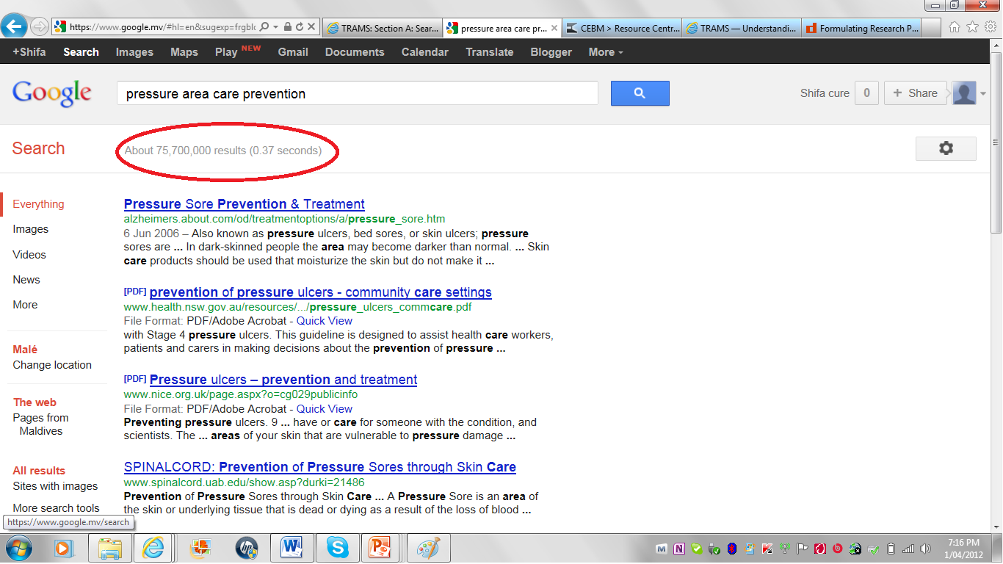

Slide 15
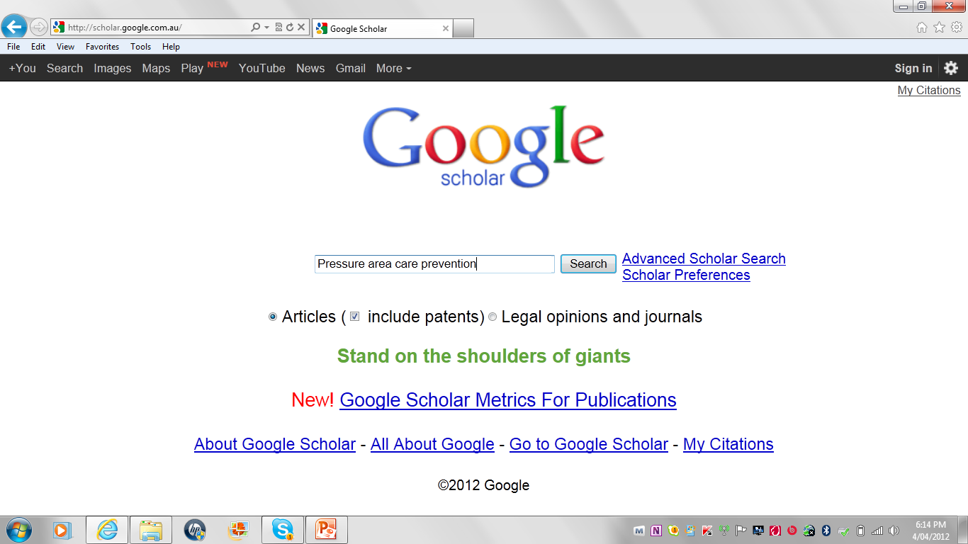

Slide 16
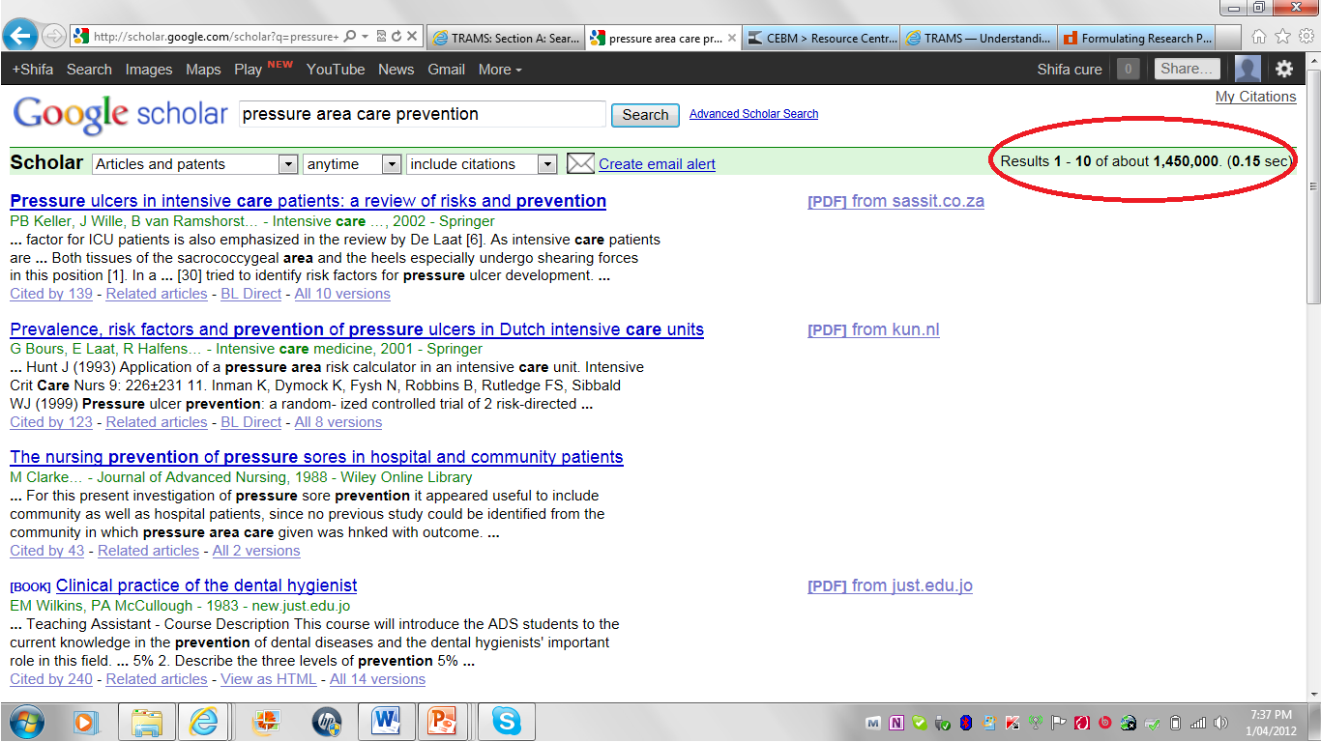

Slide 17
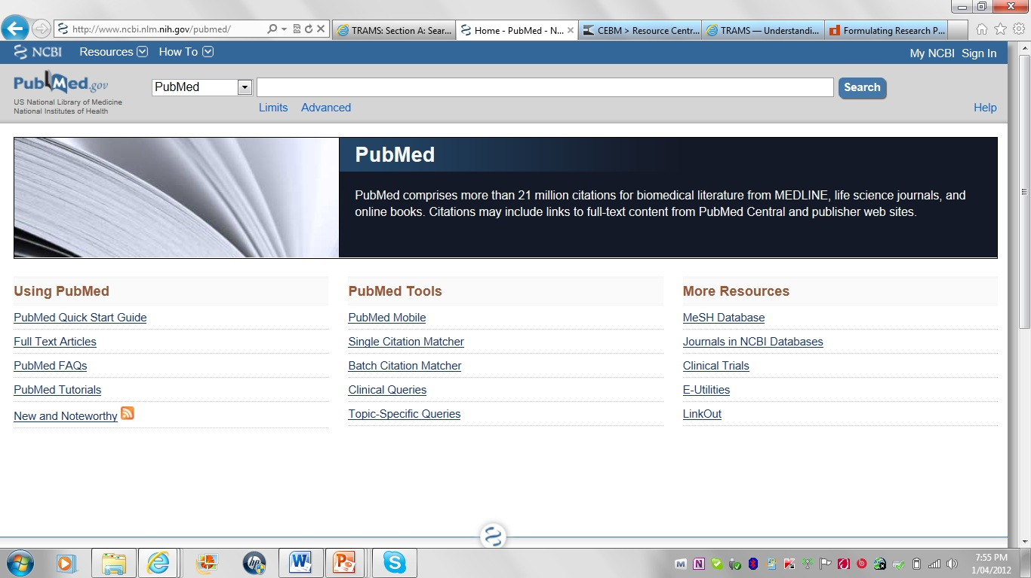
Notes:
Lets try PubMed- the national library of medicine data base. PubMed is the largest of the bibliographic data bases containing over million citations for biomedical literature from MEDLINE, science journals and online books dating from 1960s. You can find PubMed by typing www.pubmed.gov. in you web browser.
PubMed Clinical Queries is a specialised search engine intended for clinicians that has built-in search "filters" designed to find high quality studies. It includes searches designed for four study categories: therapy, diagnosis, aetiology and prognosis.
PubMed covers medicine, nursing, dentistry, vet nary science and pre clinical studies.
Now lets search PubMed for pressure ulcer prevention

Slide 18
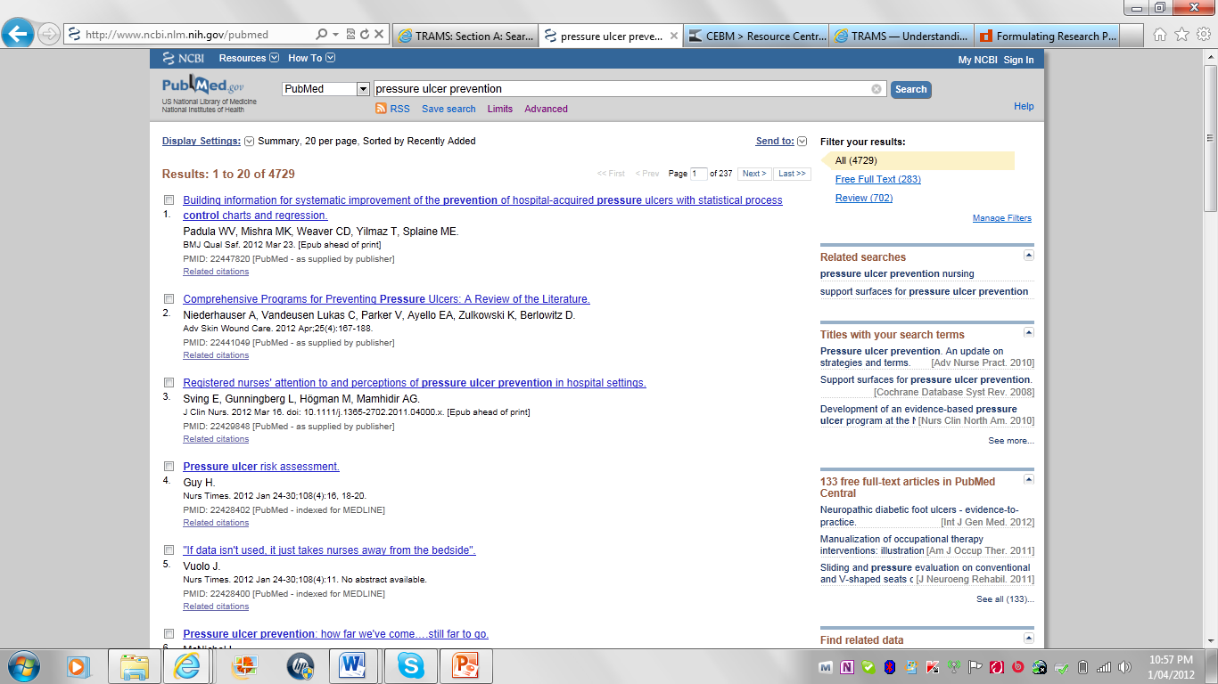
Notes:
Here you can see that there is over 4700 articles in pubMed. Some of these reports are research in animals such as mice or rats or in cells or test tubes. We don’t have time to go through all these citations.
PubMed gives some convenient ways of narrowing down your search by clicking on the limits tab.

Slide 19
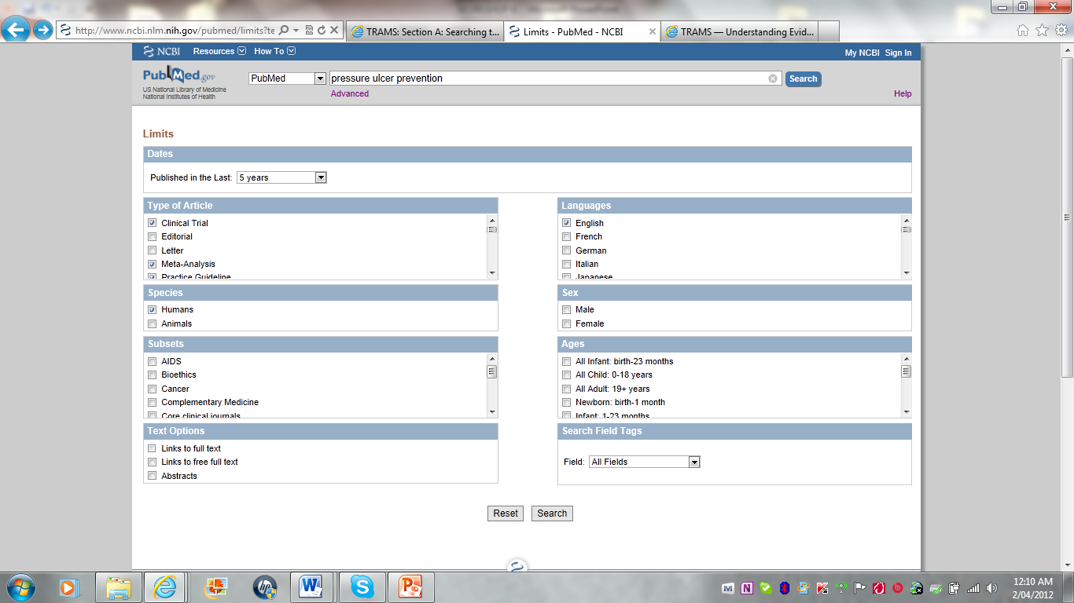
Notes:
You can limit your search in many ways by clicking the limit tab.
You can limit your articles to published date, types of articles such as clinical trials, guidelines reports, or
whether it contain human or animals, male or female,
You can also limit to language , subsets and by the age of the people been studied.
So after limiting our search we found that

Slide 20
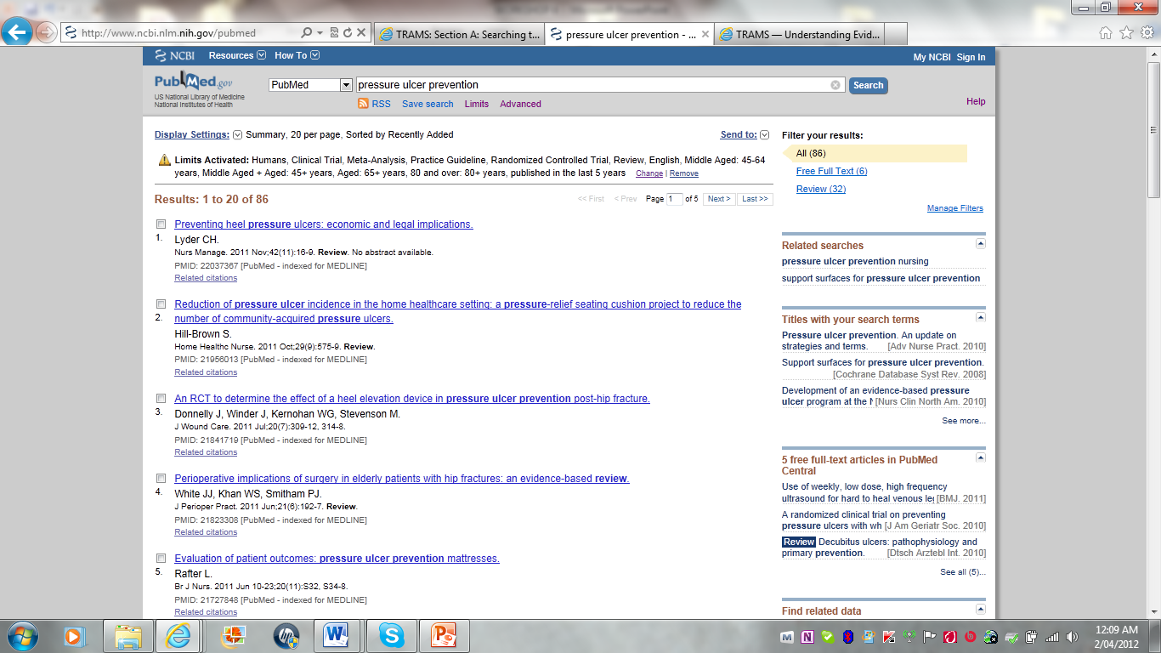

Slide 21
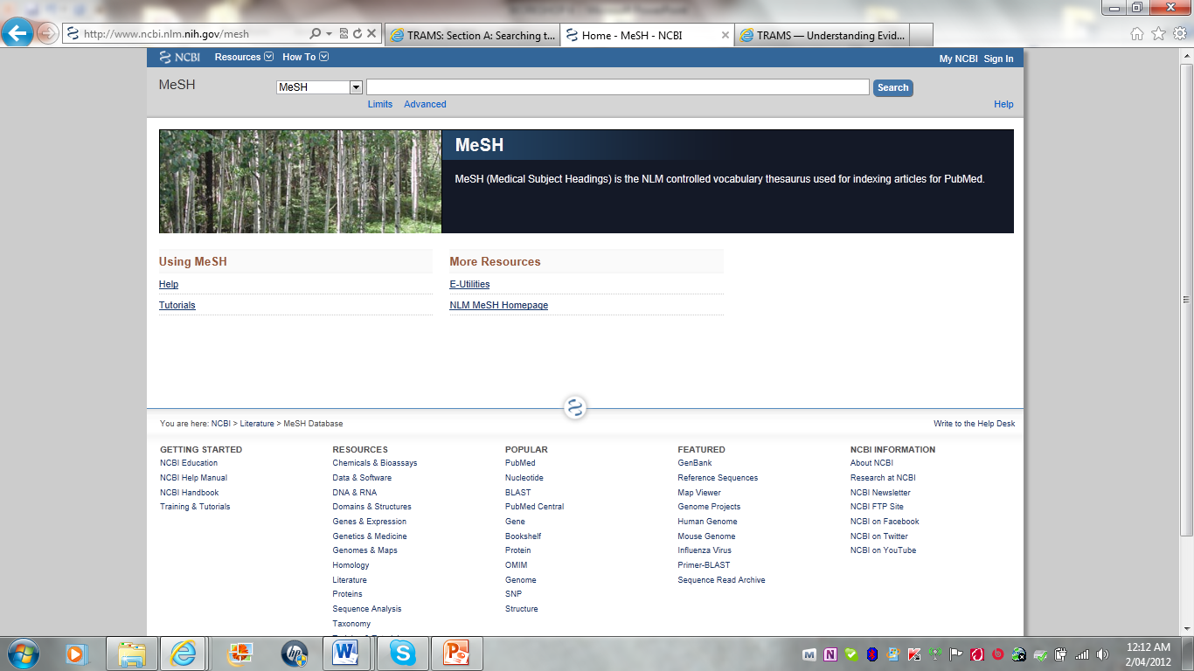

Slide 22
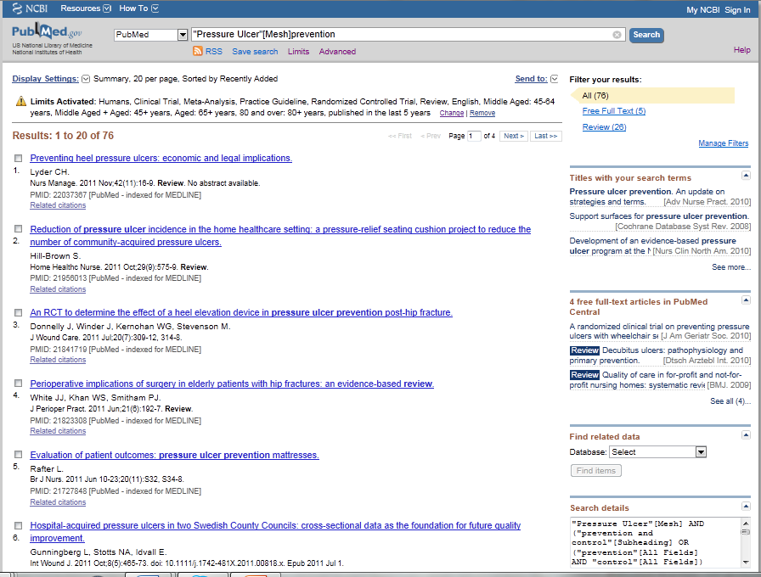

Slide 23
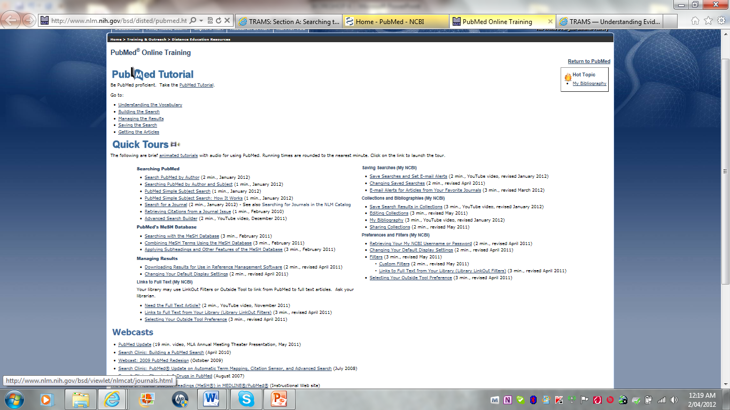
Notes:
More tutorials can be found at www.pubmed.gov on
MeSH medical subject headings
Limiting the search
Combining search terms using AND, OR and NOT
Finding related research
Saving research.

Slide 24
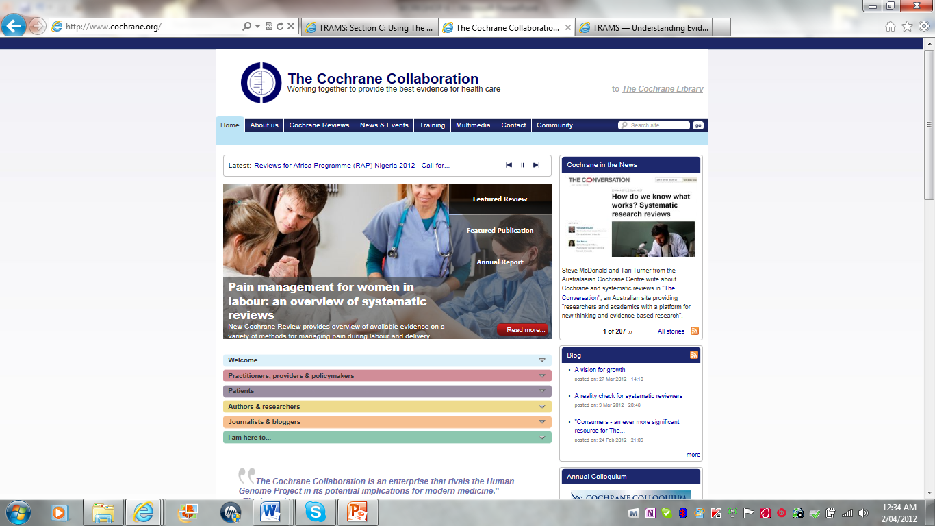
Notes:
The Cochrane Library is a regularly updated collection of evidence-based practice databases that provide high quality information about health-care interventions (though they‟re starting to look at diagnostic questions too!).
You can access it at www.thecochranelibrary.com

Slide 25
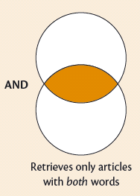
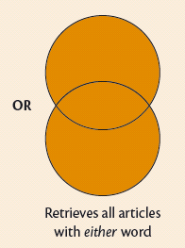
Cochrane Library- Connectors
AND narrows a search
e.g. pressure ulcer and prevention
Both words must be present in all retrieved records
OR broadens a search
eg pressure sore OR Pressure Ulcer
OR bedsore
One word or the other or both can
be present – they are alternatives

Slide 26
Cochrane Library- phrase searching
Use inverted commas “….“
eg. “bowel cancer”
This will retrieve records where the words are found in precisely the order given.

Slide 27
Cochrane Library-
grouping terms & brackets
Use brackets ( ) to dictate the order in which terms are processed when writing your search strategy
Eg: prevention and (pressure sore OR pressure ulcer)
Terms in bracket are processed first
Individual search boxes in Cochrane advanced search act in the same way as brackets in a single search box

Slide 28
Cochrane Library - word stemming
Use the asterisk symbol - *
at the end of word searches for all terms that begin with that word stem (not needed for plurals in Cochrane Library)
eg. neonat* retrieves neonate or neonates or neonatal
also works as a wildcard before a word
eg. *natal retrieves perinatal or neonatal or postnatal
also works as a wildcard within a word
eg. p*ediatric retrieves paediatric or pediatric

Slide 29
Where to search for evidence
Type of Question - Prognosis
Not a Treatment
Highest level evidence – cohort study
Therefore, can’t search Cochrane Library

Slide 30
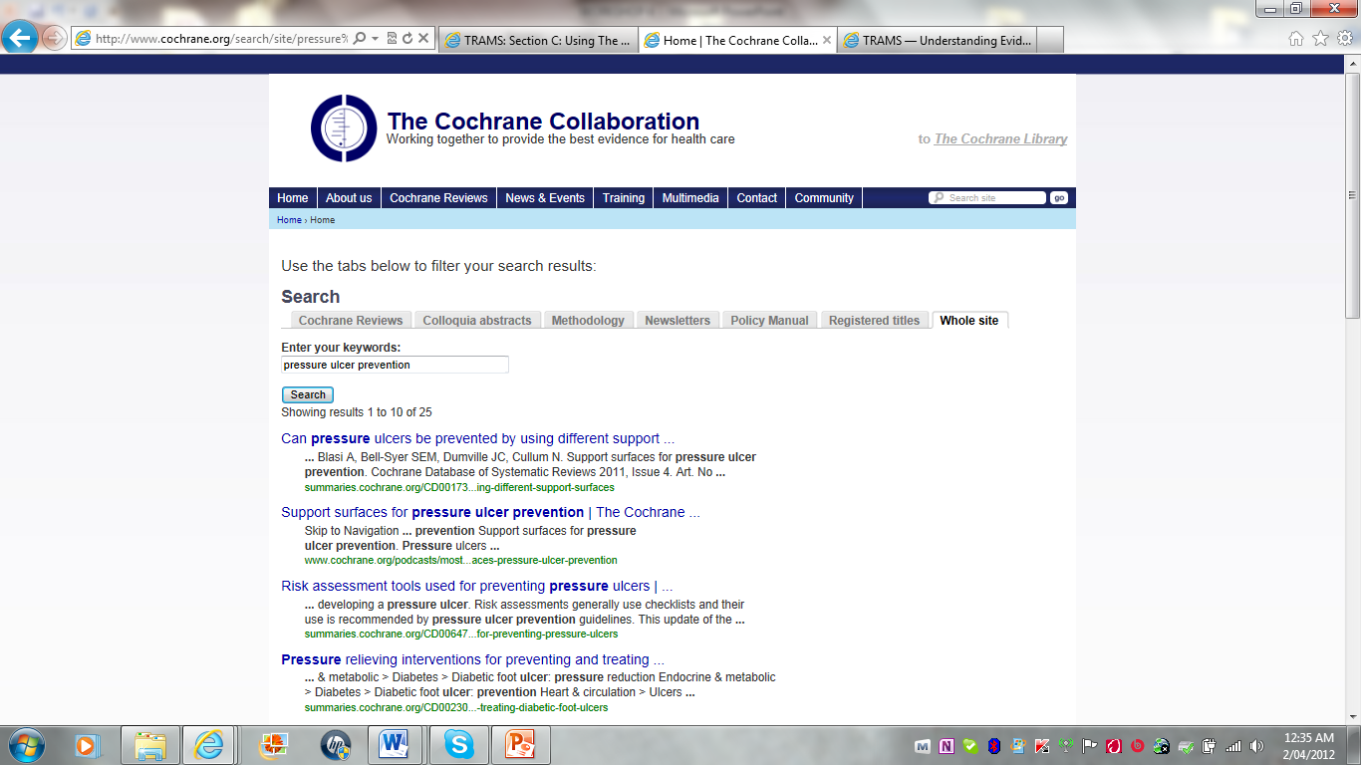

Slide 31
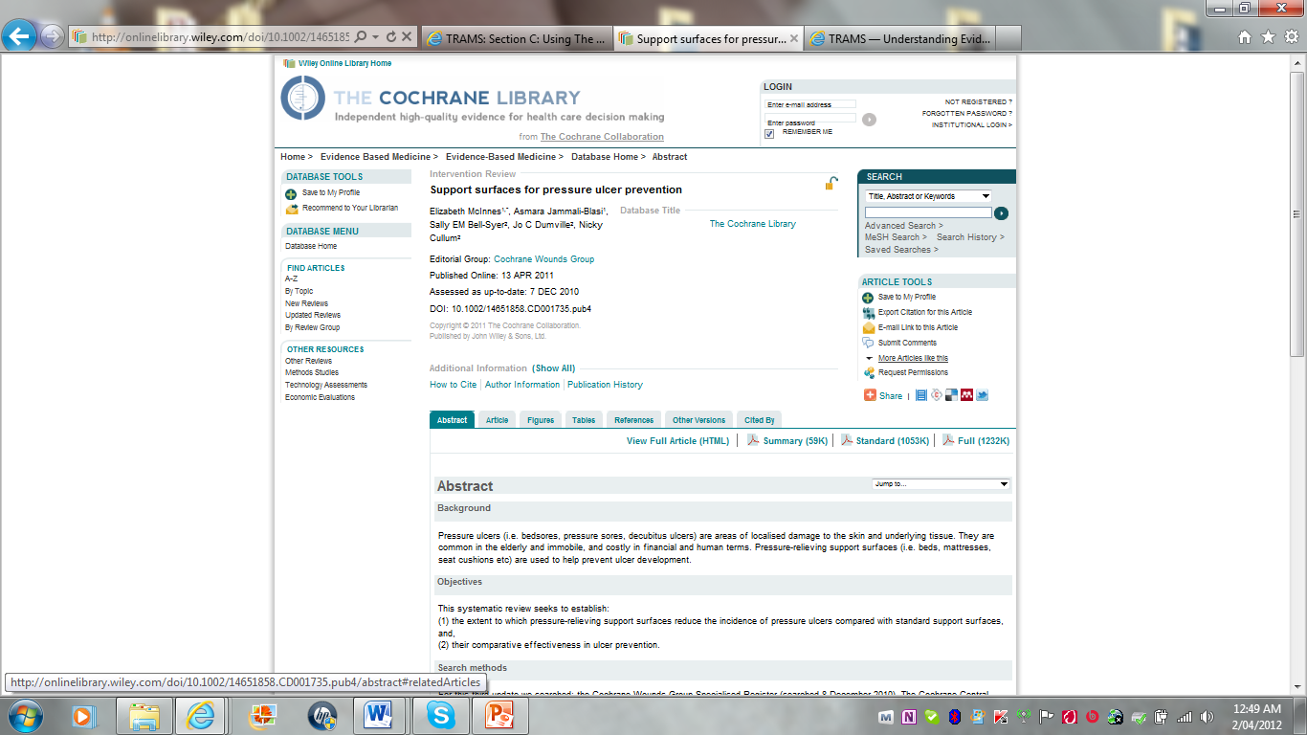

Slide 32
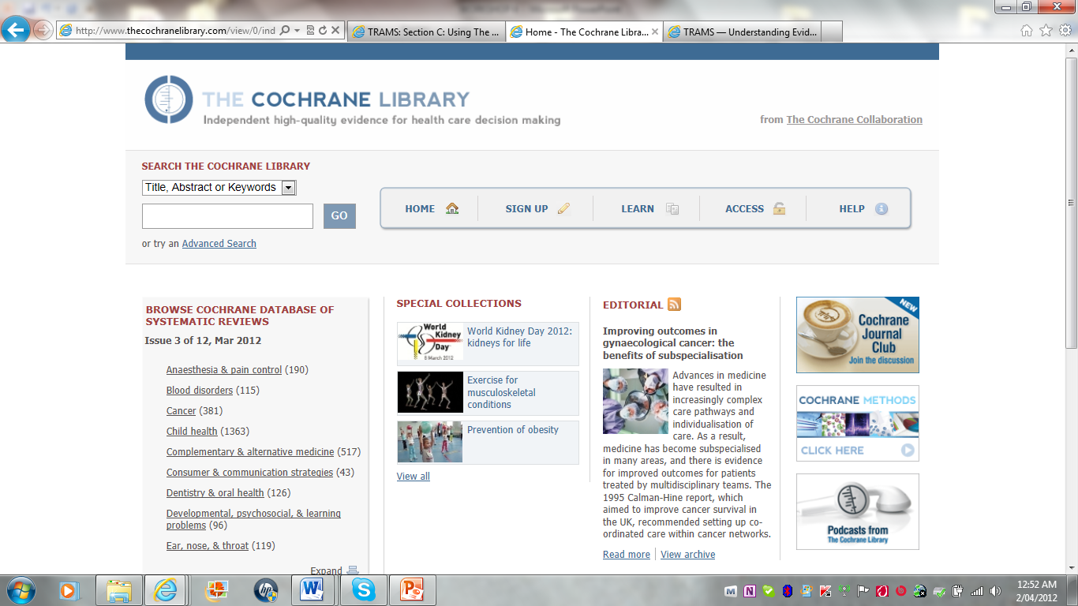

Slide 33
Free health care journals
(open access)
PubMed Central
  www.pubmedcentral.nih.gov
Biomed Central
  www.biomedcentral.com
Directory of open access journal
  www.doaj.org
Free medical journal
  www.freemedicaljournals.com

Slide 34
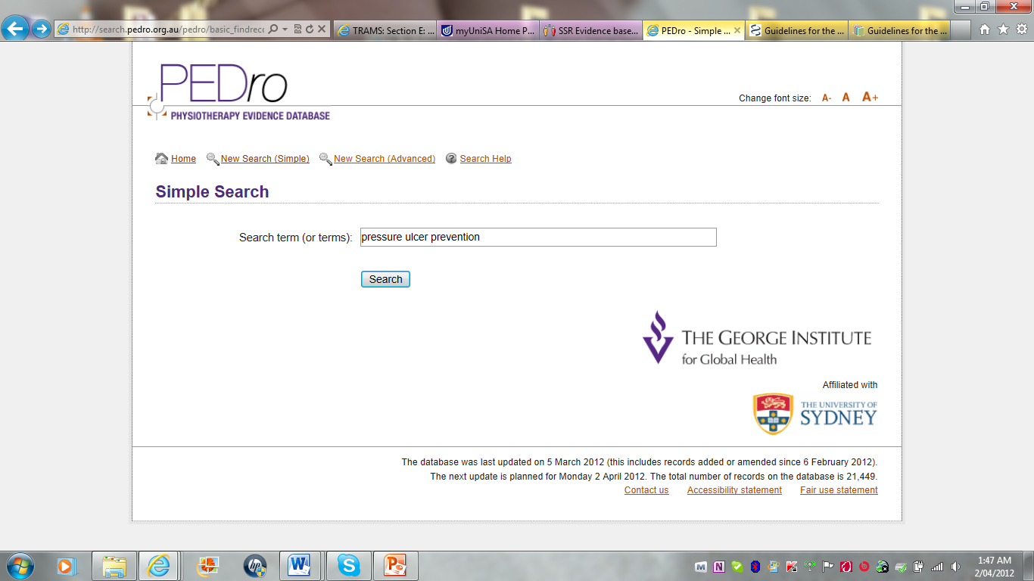

Slide 35
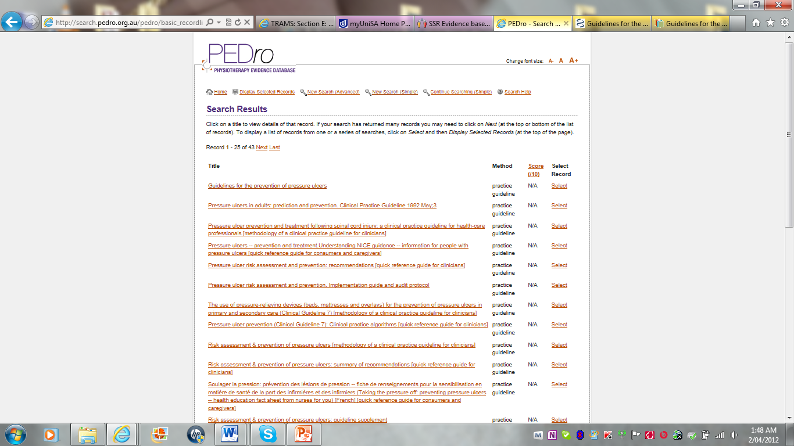

Slide 36
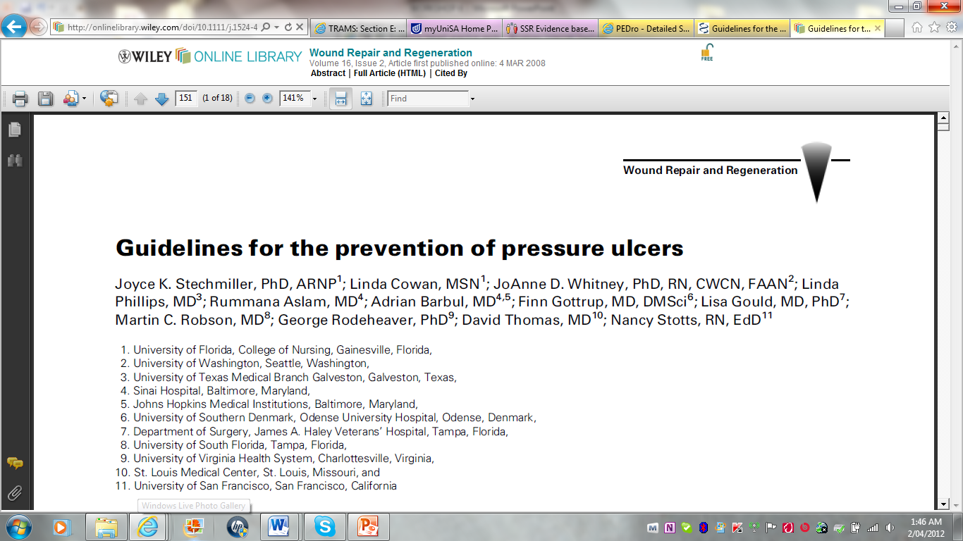

Slide 37
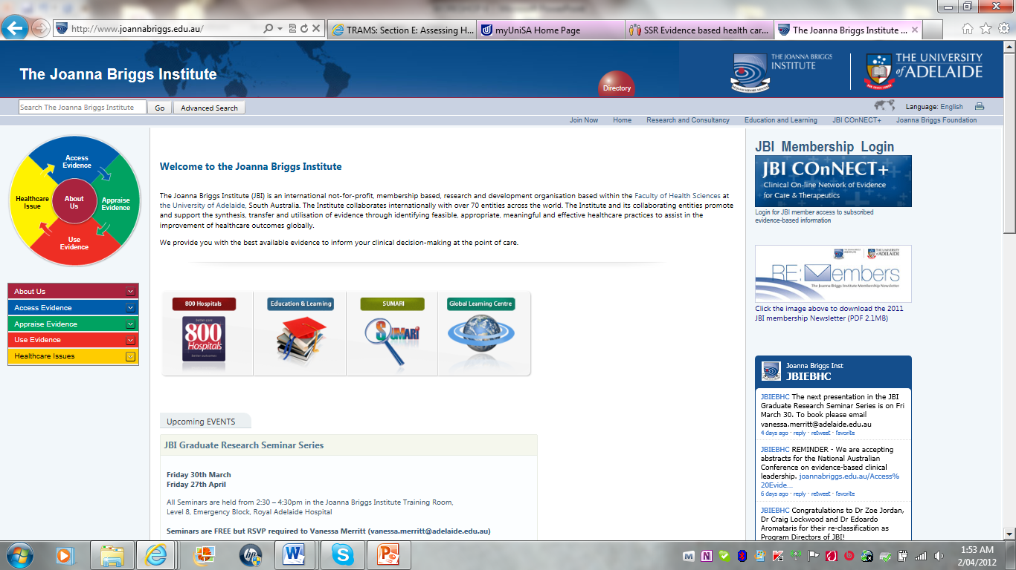
Notes:
The Joanna Briggs Institute (JBI) is an international collaboration which was founded in Adelaide in 1996. It is a key source of evidence based practice in nursing and midwifery, physiotherapy, occupational therapy, podiatry and other allied health areas. Some JBI resources are free.

Slide 38
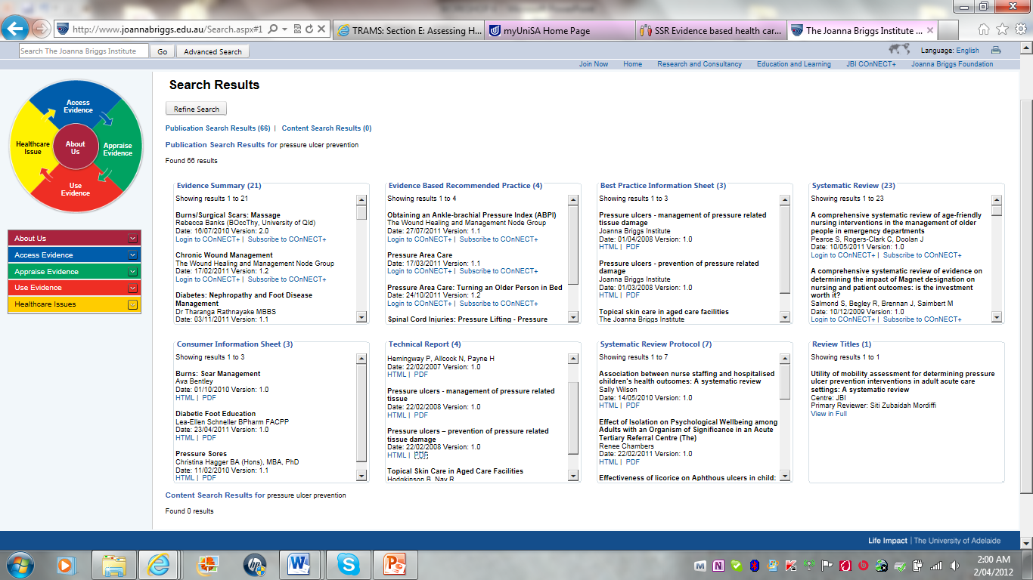

Slide 39
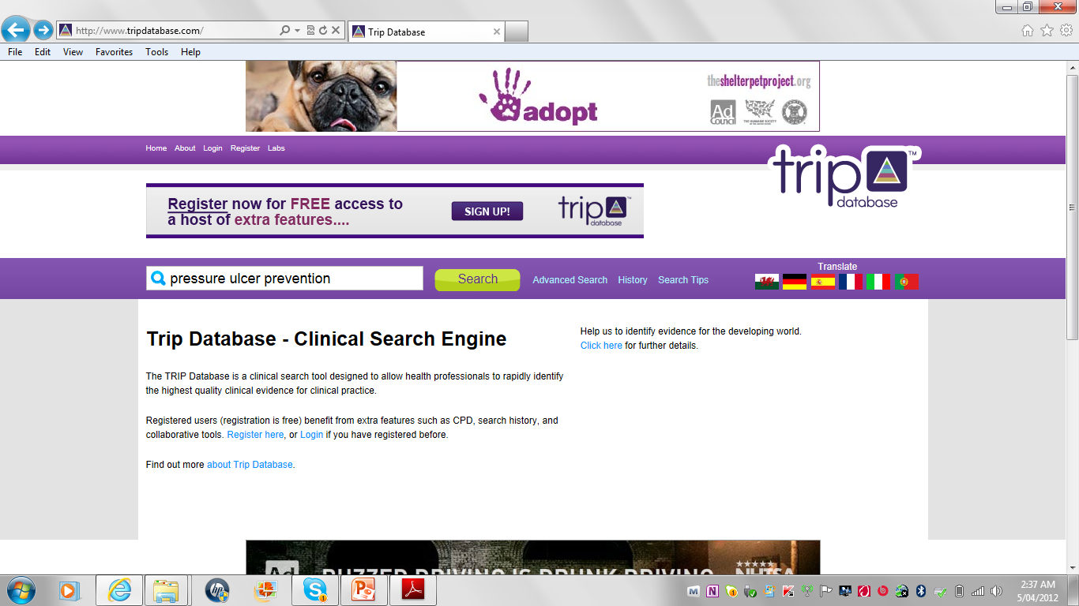

Slide 40
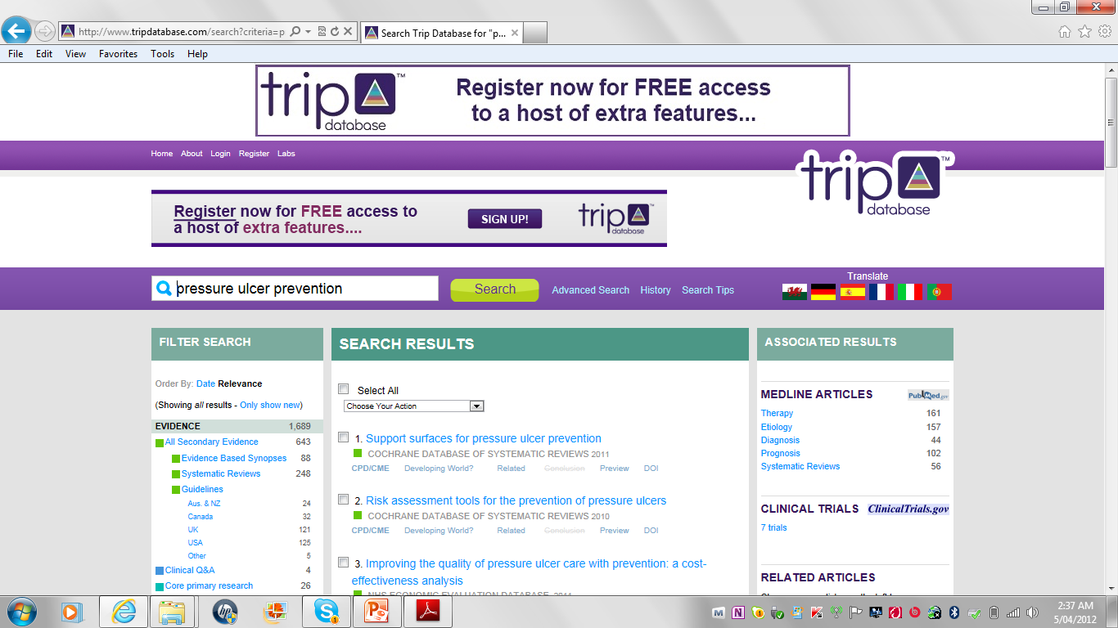

Slide 41
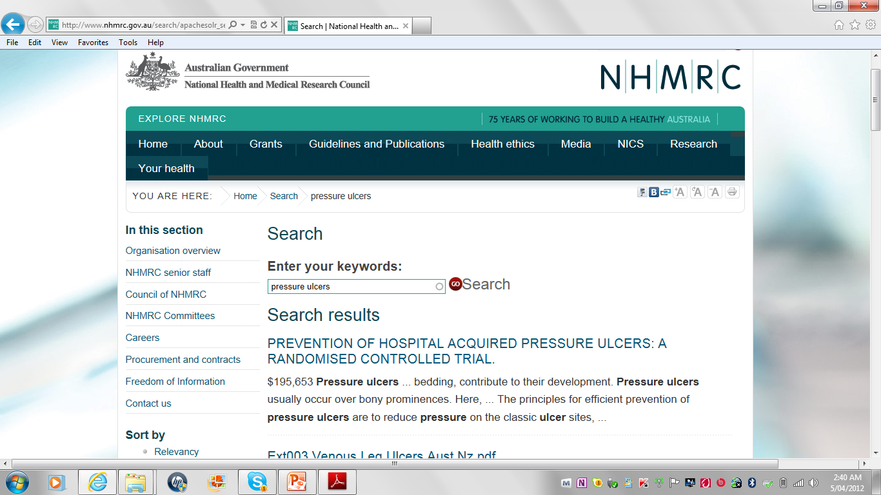

Slide 42
More Resources
Clinical Practice Guidelines such as
National Health and Medical Research Council
www.nhmrc.gov.au/publications/subjects/clinical.htm
National Institute for Health and Clinical Excellence
www.nice.org.uk
New Zealand Guideline Group
www.nzgg.org.nz

Slide 43
Other Sources of Evidence Reviews, such as
The Centre for Clinical Effectiveness
www.mihsr.monash.org/cce
Clinical Evidence
www.clinicalevidence.com
Best Bets
www.bestbets.org
TIRP Database
www.tripdatabase.com

Slide 44
Managing References Software
Helps to create a database of references including those found in online databases and catalogue.
Can be inserted to word document and use to create bibliographies in different styles.

Slide 45

Computer lab literature search

Slide 46

BREAK
Notes:
Welcome to the first workshop on EBP. In this workshop you will be learning about the key concepts of EBP. When you complete this workshop you will be able to explain what is EBP and discuss its importance, able to identify the steps involved in EBP, challenges and barriers to the uptake of EBP.

Slide 47

Comp Lab Group Work

Slide 48
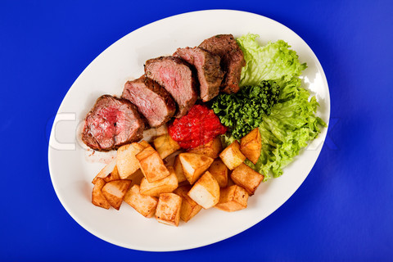
LUNCH BREAK

Slide 49

Comp Lab Group Work
Contd…….

Slide 50

Presentations

Slide 51

Question and Answers

Slide 52

Thank you

